Slide 1

Data Structures
Wladymir Brborich

Slide 2
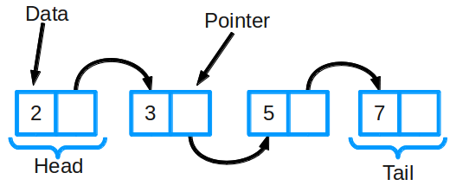
What is a data structure?
It is an storage format that allows you quick access and data manipulation.
You may call it a collection of values
They are the key to design efficient algorithms

Slide 3
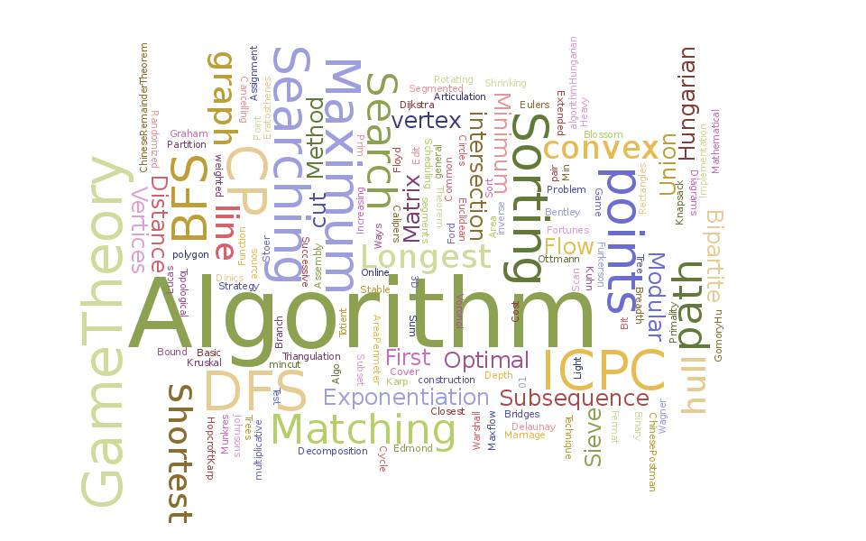
Common ones
Arrays
Linked List
Structs
Objects
Hash Tables

Slide 4

Arrays
Basic collection of finite elements
Index based
Use it when you know exactly how many elements you will have
May be dynamic, but it is a pain

Slide 5
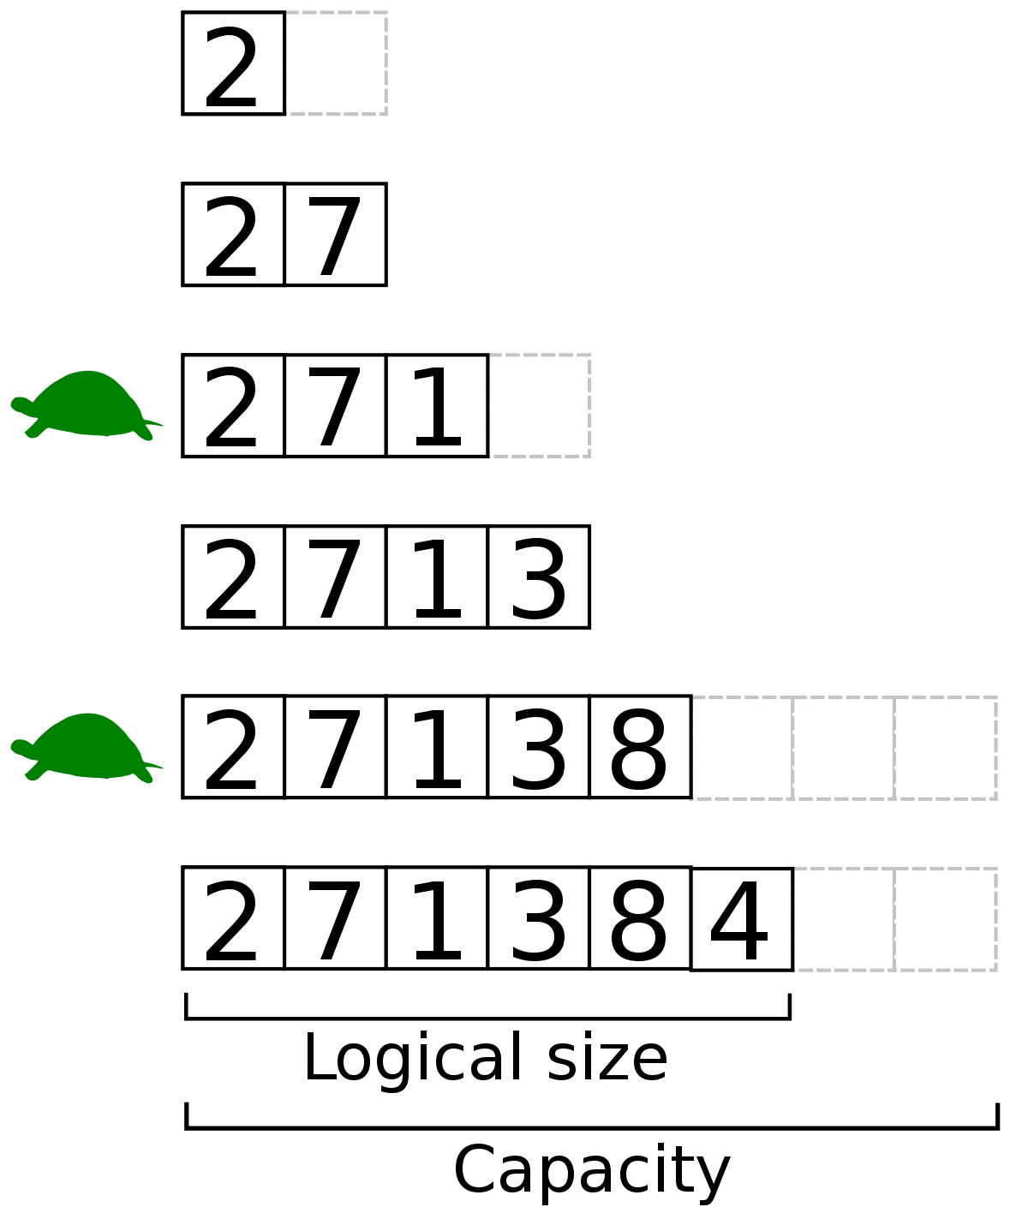
Lists, ArrayLists
A collection of infinite* elements
Evolution of previous arrays
Index based
Not the same as a dynamically located array
Use it when you don’t know how many elements you will manage

Slide 6
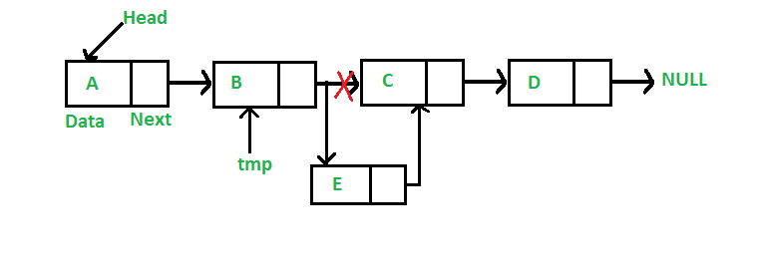
Linked Lists
Dynamic, and super fast as storage methods
Do not support random access
Elements do not need to be stored continuously on memory
Slow lookups and searches

Slide 7
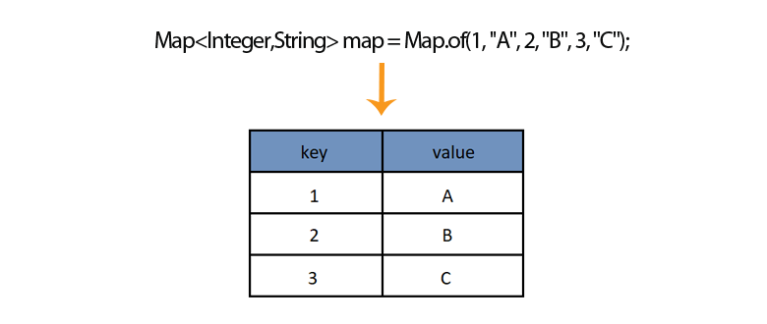
HashMaps, Dictionaries
Dynamic, but not index based
Super fast search's by key
Keys can not repeat themselves

